Slide 1
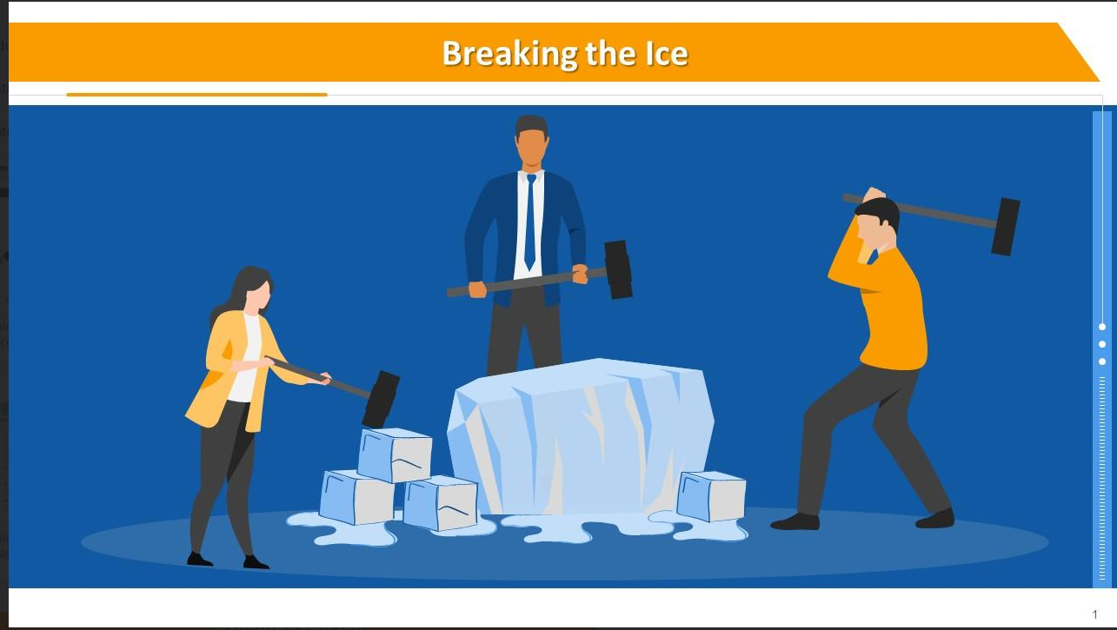

Slide 2
Timeline of today Session
Recap
Session first half
Workshop1
Workshop2
Session Second half

Slide 3

Wake up!

Slide 4


The real thing
For simulation
Arduino IDE
Tinker Cad

Slide 5
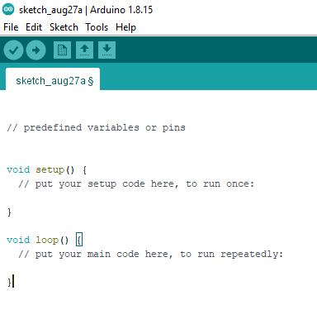
Void setup?
Void Loop?

Slide 6

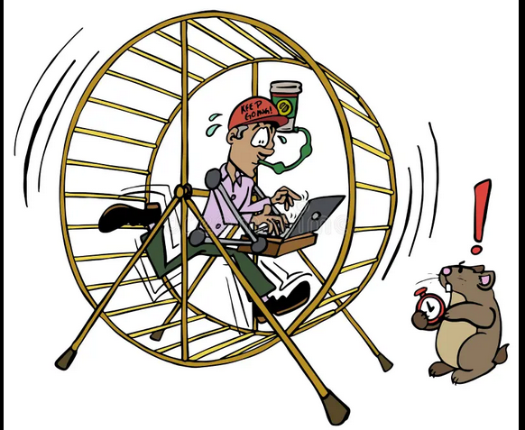
Which is Which

Slide 7
Functions
pinMode(#,?)
what should be replaced with ‘#’
what should be replaced with ‘?’

Slide 8

Functions
digitalRead()
digitalWrite()
Give example of a component ??
Same goes here

Slide 9

analogRead()
analogWrite()
Do u remember the range of values for analog???

Slide 10
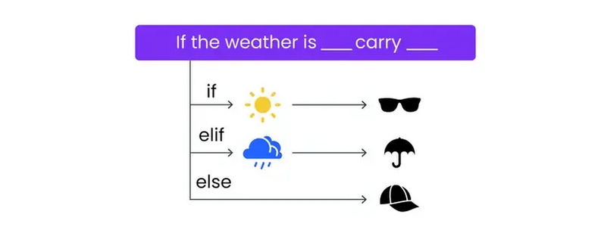
Conditonals
if(its sunny)
{
wear glasses
}
else if(its raining)
{
hold your umbrella
}
else
{
Wear a cap
}

Slide 11

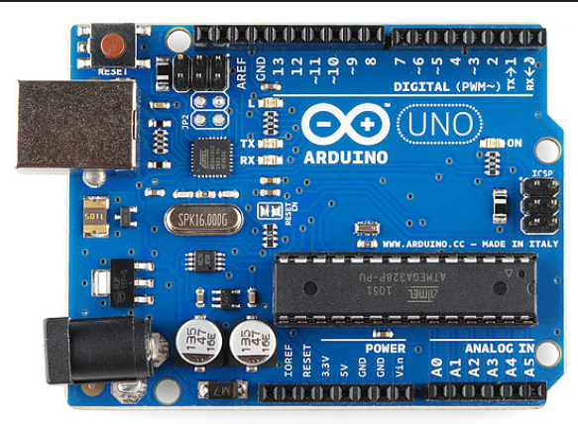
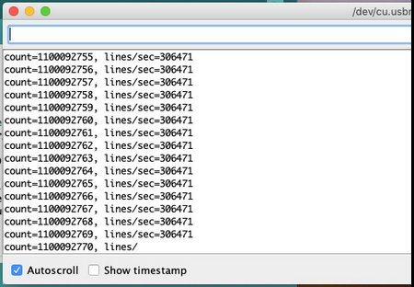
Serial Monitor

Slide 12

What’s a Sensor?

Slide 13
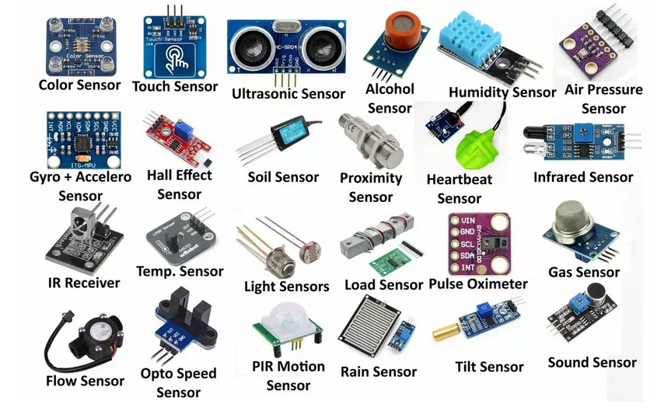
Different types of sensors out there

Slide 14
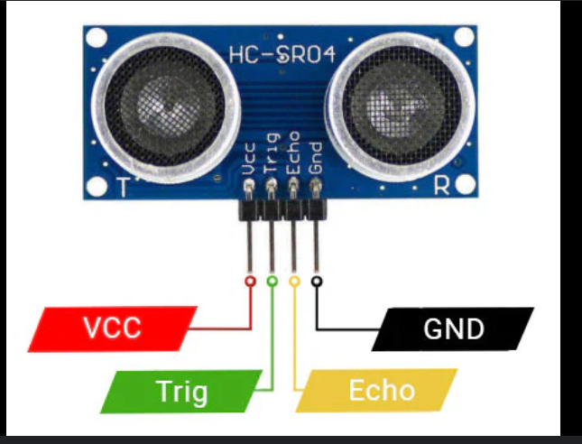
Ultrasonic Sensor

Slide 15
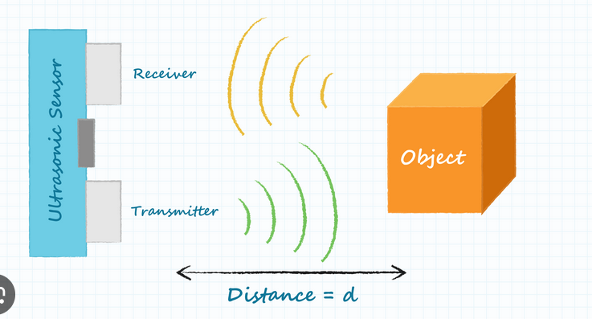
How it
works

Slide 16
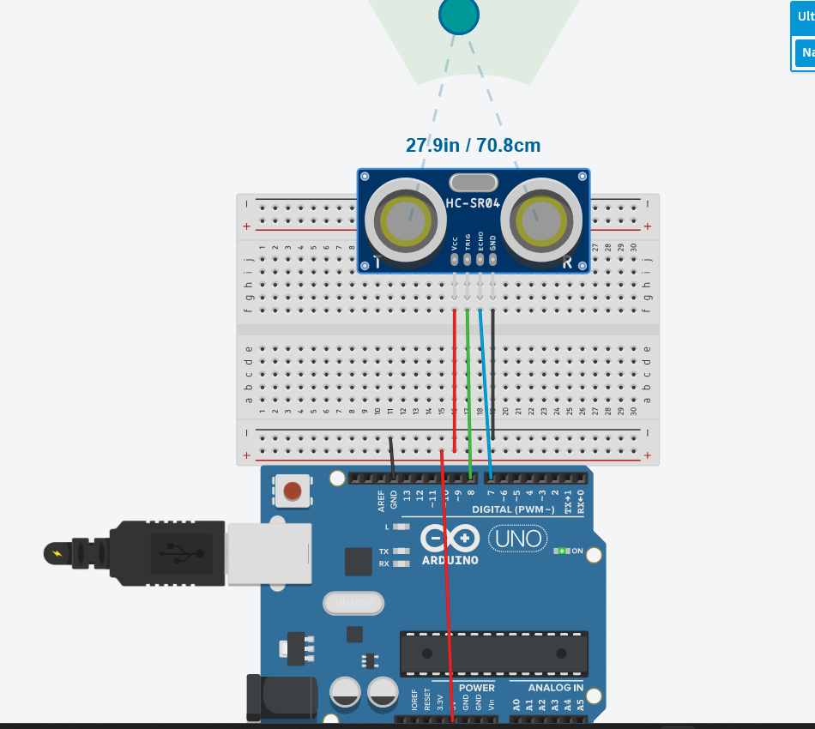

Slide 17
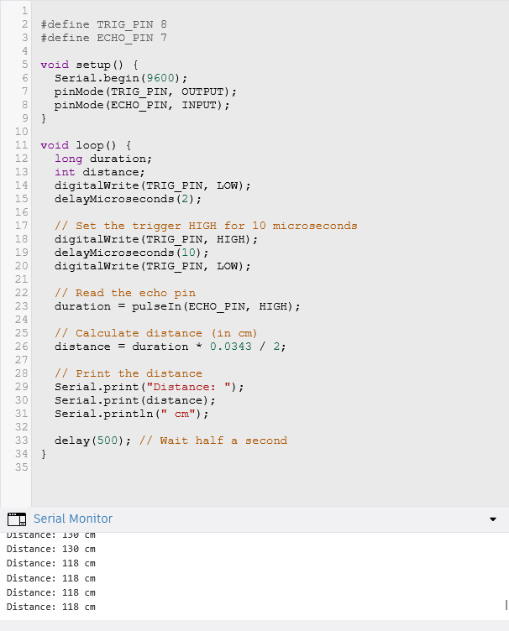

So that’s how an Ultrasonic work

Slide 18
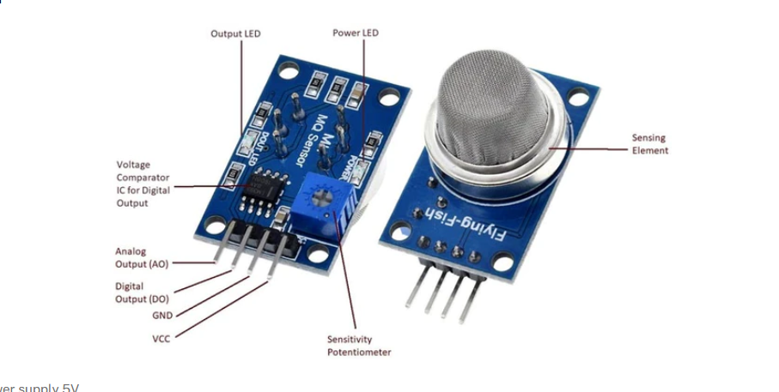
Gas Sensor

Slide 19
illustration video

Slide 20
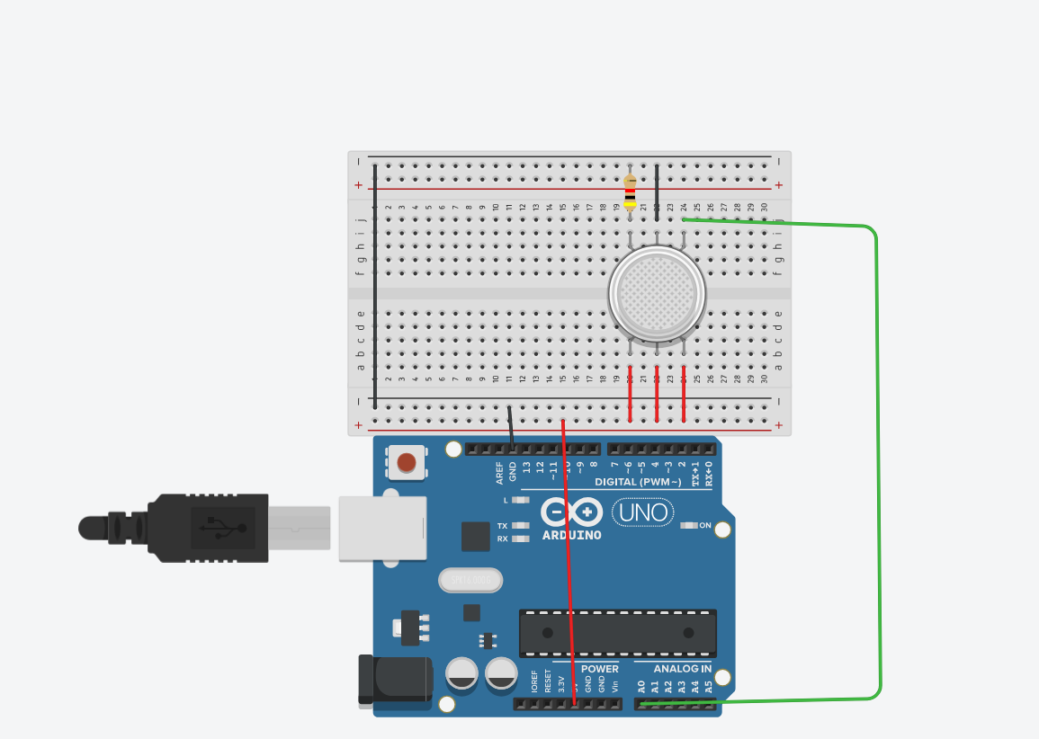

Slide 21
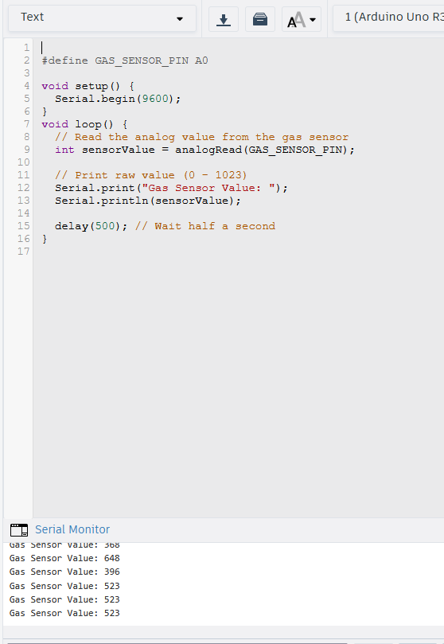

Slide 22
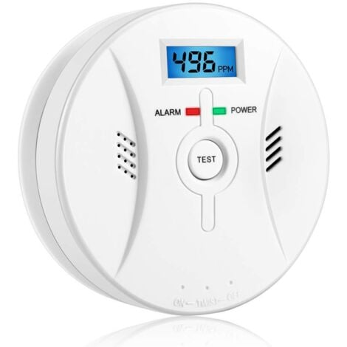
An application: Home safety gas detector like detecting carbon monoxide CO

Slide 23
Workshop 1 Time

Slide 24
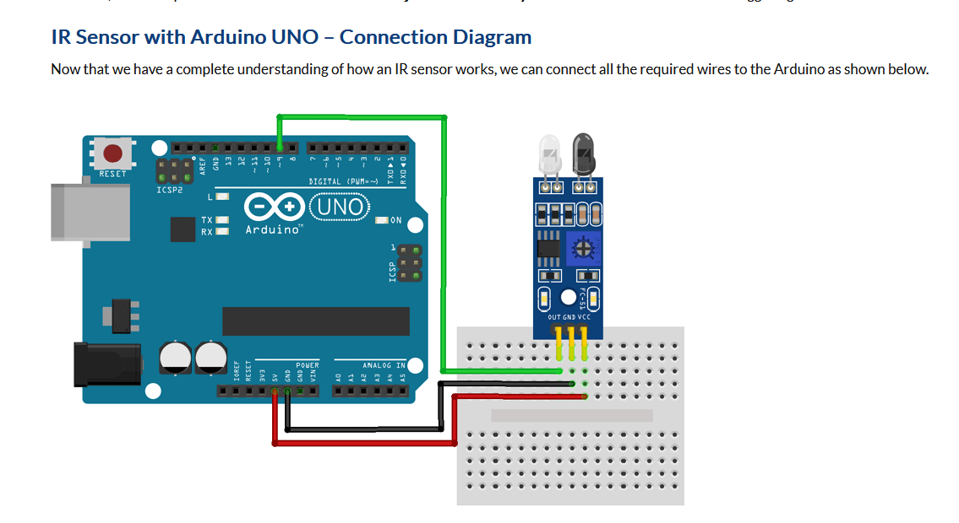
Infrared Sensor

Slide 25
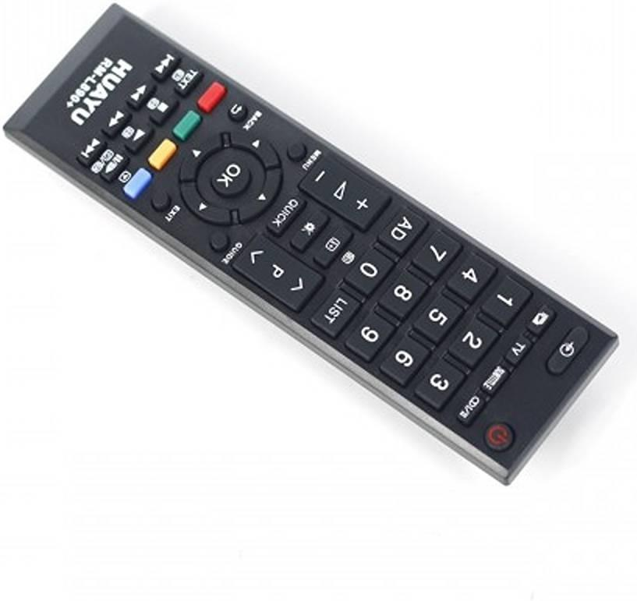
An application

Slide 26
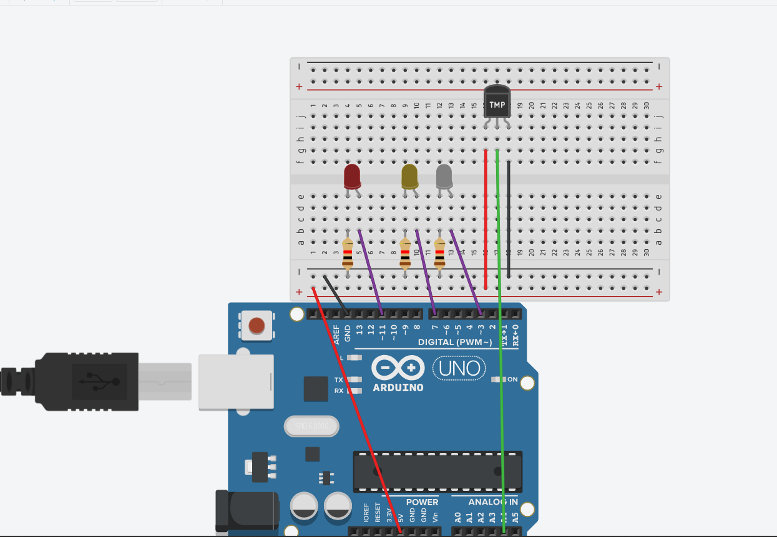
Temperature Sensor

Slide 27
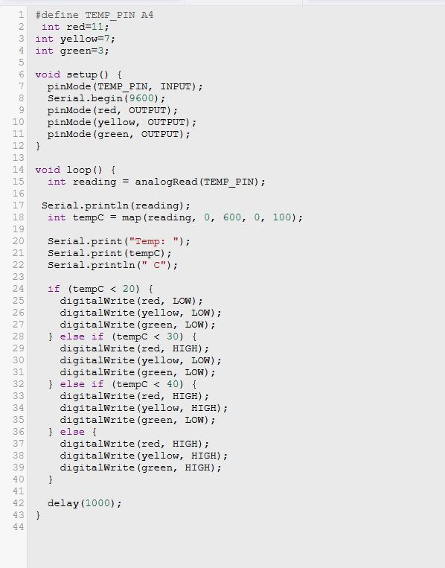
Temperature Sensor

Slide 28
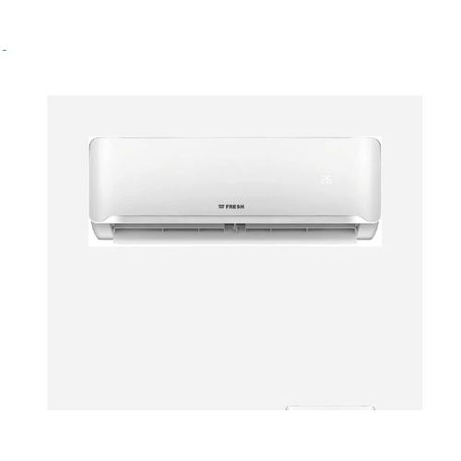
An application

Slide 29
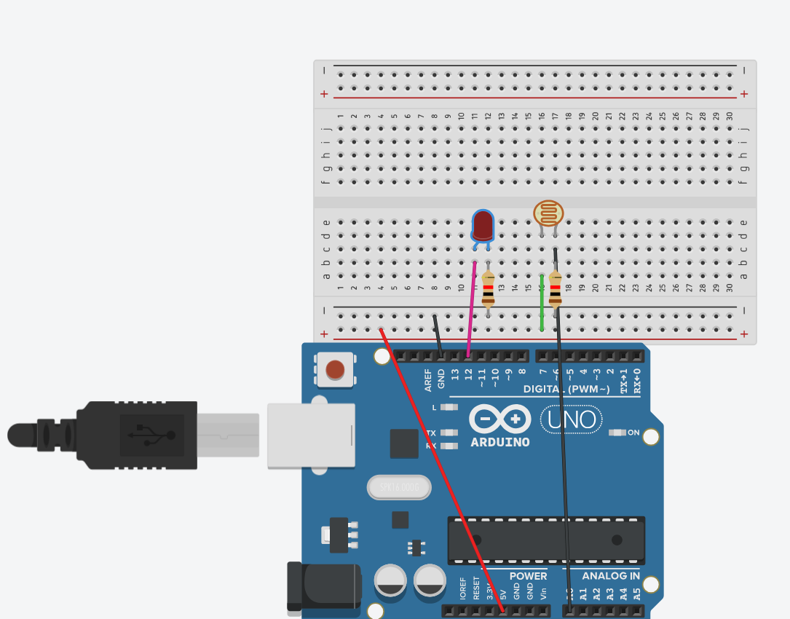
LDR (Light dependent resistor)

Slide 30
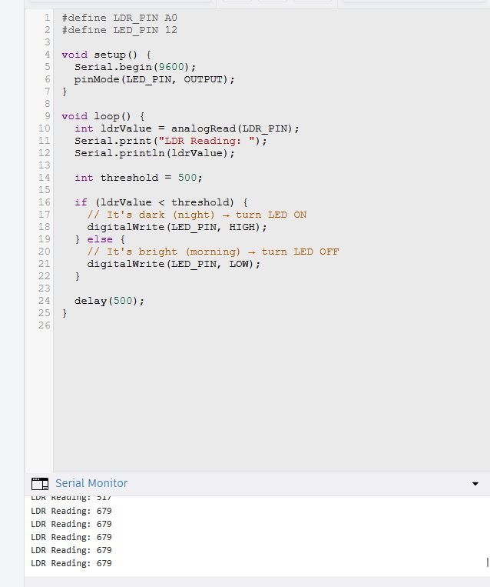
LDR

Slide 31
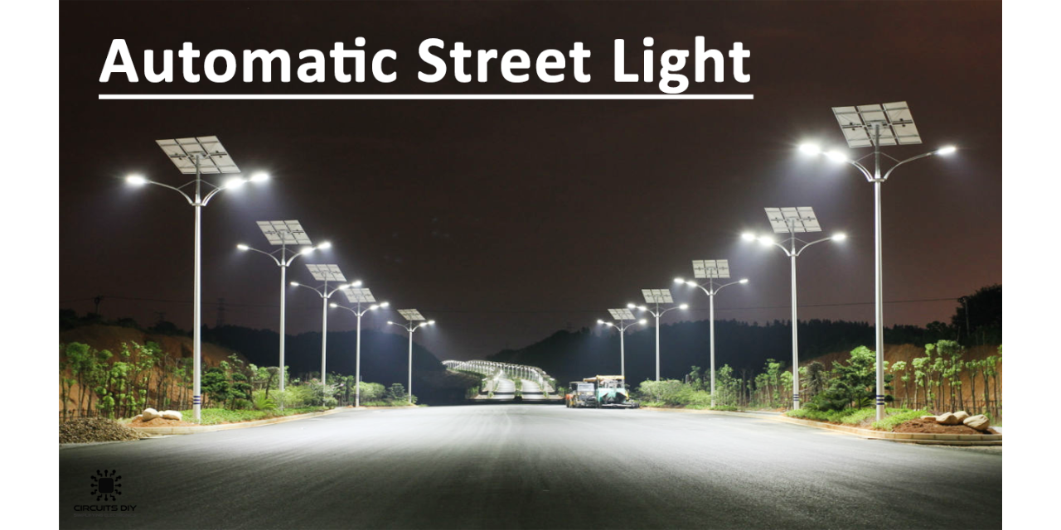
An application

Slide 32
Workshop 2 Time

Slide 33
Thank you!

